Slide 1

19ECS204: OPERATING SYSTEMS
School Of Technology Bengaluru Campus

Slide 2
Module 3
Chapter 1:
Process Synchronization: Critical section problem, Peterson’s solution, synchronization hardware, Mutex locks, semaphores, classic problems of synchronization, monitors.
Chapter 2:
Deadlock: System model, deadlock characterization, deadlock prevention, detection and avoidance, recovery from deadlock.

Slide 3
Chapter 1: Process Synchronization
The Critical-Section Problem
Peterson’s Solution
Synchronization Hardware
Mutex Locks
Semaphores
Classic Problems of Synchronization
Monitors

Slide 4
Objectives
To present the concept of process synchronization.
To introduce the critical-section problem, whose solutions can be used to ensure the consistency of shared data
To present both software and hardware solutions of the critical-section problem
To examine several classical process-synchronization problems
To explore several tools that are used to solve process synchronization problems

Slide 5
Producer
while (true)
{
/* produce an item and put in nextProduced */
while (counter== BUFFER_SIZE)
; // do nothing
buffer [in] = nextProduced;
in = (in + 1) % BUFFER_SIZE;
counter++;
}

Slide 6
Consumer
while (true)
{
while (counter == 0)
; // do nothing
nextConsumed = buffer[out];
out = (out + 1) % BUFFER_SIZE;
counter--;
/* consume the item in nextConsumed
}

Slide 7
Race Condition
counter++ could be implemented as register1 = counter register1 = register1 + 1 counter = register1
counter-- could be implemented as register2 = counter register2 = register2 - 1 counter = register2

Slide 8
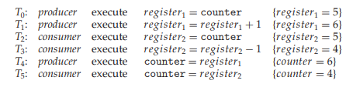
Race Condition

Slide 9
Critical section problem
p1—-SET OF CODE
eNTRY
Critical section – segment of code
changing common variables
Updating a table
Writing a file etc.
Entry section
Exit section
Remainder section
CRITICAL SECTION
EXIT
REMAINING

Slide 10
Critical section problem
do
{
critical section
remainder section
}while (TRUE);
Figure: General structure of a typical process P_{i}
Entry section
Exit section

Slide 11
Solution to Critical-Section Problem
1. Mutual Exclusion - If process P_{i} is executing in its critical section, then no other processes can be executing in their critical sections
Progress - If no process -critical section
some process - enter their critical section,
selection cannot be postponed indefinitely
3.Bounded Waiting - A bound must exist on the number of times that other processes are allowed to enter their critical sections

Slide 12
Ex:
Kernel – maintaining list of open files
Approaches to handle critical section in OS:
Preemptive kernels: allows a process to be preempted while it is running in kernel mode
Ex: Linux 2.6 kernel
Nonpreemptive kernels: does not allow a process running in kernel mode to be preempted
Ex: Windows XP, Windows 2000

Slide 13
Peterson’s Solution
s/w based solution to critical-section problem
Two process solution – P_{i} & P_{j}
The two processes share two variables:
int turn; 🡪 indicates whose turn it is to enter the critical section.
boolean flag[2] 🡪 indicates if a process is ready to enter the critical section
flag[i] = true 🡺 process P_{i} is ready!

Slide 14
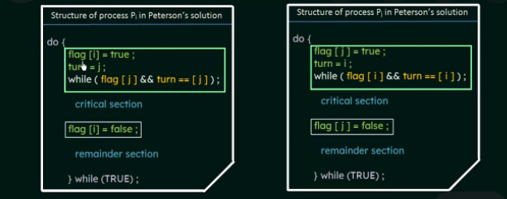

Slide 15
1. How mutual exclusion is preserved?
P_{i} to enter into critical section: flag[j]=0
turn=i
2. If both P_{i} and P_{j} execute critical section at same time:
flag[0] = flag[1] = 1
turn = i or j 🡪 only one is possible

Slide 16
2. How progress requirement and bounded waiting requirements are satisfied?
P_{i} can be prevented from entering critical section if :
flag[j] = 1 & turn = j
If P_{j} is not ready to enter the critical section, then
flag[j] = 0
P_{i} can enter into critical section
If P_{j} has set flag[j] = 1 & executing remainder section, then turn = i or turn = j.
If turn = i 🡺 P_{i} will enter critical section
If turn = j 🡺 Pj will enter critical section

Slide 17
Synchronization Hardware
Solution to critical section problem requires a tool 🡪 lock
Critical regions protected by locks -> prevents race conditions
do
{
critical section
remainder section
} while (TRUE);
Uniprocessors : prevent interrupts from occurring while modifying shared variable.
Won’t work in multiprocessor environment because disabling interrupts is time consuming
acquire lock
release lock

Slide 18
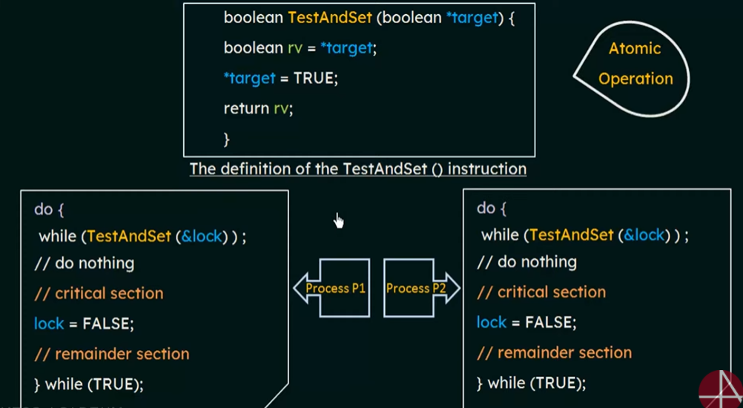
TestAndSet Instruction

Slide 19
Swap Instruction
Definition:
void Swap (boolean *a, boolean *b)
{
boolean temp = *a;
*a = *b;
*b = temp:
}

Slide 20
Solution using Swap
Shared Boolean variable lock initialized to FALSE; Each process has a local Boolean variable key
Solution:
do {
key = TRUE;
while ( key == TRUE)
Swap (&lock, &key );
// critical section
lock = FALSE;
// remainder section
} while (TRUE);

Slide 21
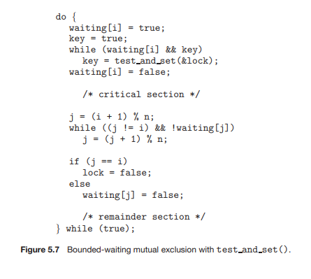


Slide 22
Semaphore
Synchronization tool that does not require busy waiting
Semaphore S 🡪 integer variable
Two standard operations modify S: wait() and signal()
Originally called P() and V()
Less complicated
Can only be accessed via two indivisible (atomic) operations
wait (S)
{
while S <= 0
; // no-op
S--;
}
signal (S)
{
S++;
}

Slide 23
Semaphore as General Synchronization Tool
Counting semaphore – integer value can range over an unrestricted domain
Binary semaphore – integer value can range only between 0 and 1; can be simpler to implement
Also known as mutex locks
Can implement a counting semaphore T as a binary semaphore
Provides mutual exclusion
semaphore mutex; // initialized to 1
do {
wait (mutex);
// Critical section
signal (mutex);
// remainder section
} while (TRUE);

Slide 24
Semaphore Implementation
Must guarantee that no two processes can execute wait () and signal () on the same semaphore at the same time
Thus, implementation becomes the critical section problem where the wait and signal code are placed in the crtical section.
Could now have busy waiting in critical section implementation
But implementation code is short
Little busy waiting if critical section rarely occupied
Note that applications may spend lots of time in critical sections and therefore this is not a good solution.

Slide 25
Semaphore Implementation with no Busy waiting
With each semaphore there is an associated waiting queue. Each entry in a waiting queue has two data items:
value (of type integer)
pointer to next record in the list
Two operations:
block – place the process invoking the operation on the appropriate waiting queue.
wakeup – remove one of processes in the waiting queue and place it in the ready queue.
typedef struct {
int value;
struct process *list;
}semaphore;

Slide 26
Semaphore Implementation with no Busy waiting (Cont.)
Implementation of wait:
wait(semaphore *S) {
S->value--;
if (S->value < 0) {
add this process to S->list;
block();
}
}
Implementation of signal:
signal(semaphore *S) {
S->value++;
if (S->value <= 0) {
remove a process P from S->list;
wakeup(P);
}
}

Slide 27
Deadlock and Starvation
Deadlock – two or more processes are waiting indefinitely for an event that can be caused by only one of the waiting processes
Let T and Q be two semaphores initialized to 1
P₀ P₁
wait (T); wait (Q);
wait (Q); wait (T);
. .
. .
. .
signal (T); signal (Q);
signal (Q); signal (T);
Starvation – indefinite blocking. A process may never be removed from the semaphore queue in which it is suspended
Priority Inversion - Scheduling problem when lower-priority process holds a lock needed by higher-priority process

Slide 28
Classical Problems of Synchronization
Bounded-Buffer Problem
Readers and Writers Problem
Dining-Philosophers Problem

Slide 29
Bounded-Buffer Problem
n buffers, each can hold one item
Semaphore mutex initialized to the value 1
Semaphore full initialized to the value 0
Semaphore empty initialized to the value n

Slide 30
Bounded Buffer Problem (Cont.)
The structure of the producer process:
do { // produce an item in nextp
wait (empty);
wait (mutex);
// add the item to the buffer
signal (mutex);
signal (full);
} while (TRUE);

Slide 31
Bounded Buffer Problem (Cont.)
The structure of the consumer process
do {
wait (full);
wait (mutex);
// remove an item from buffer to nextc
signal (mutex);
signal (empty);
// consume the item in nextc
} while (TRUE);

Slide 32
Readers-Writers Problem
A data set is shared among a number of concurrent processes
Readers – only read the data set; they do not perform any updates
Writers – can both read and write
Problem – allow multiple readers to read at the same time. Only one single writer can access the shared data at the same time
Shared Data
Data set
Semaphore mutex initialized to 1
Semaphore wrt initialized to 1
Integer readcount initialized to 0
semaphore mutex, wrt;
int readcount;

Slide 33
Readers-Writers Problem (Cont.)
The structure of a writer process:
do {
wait (wrt) ;
// writing is performed
signal (wrt) ;
} while (TRUE);

Slide 34
Readers-Writers Problem (Cont.)
The structure of a reader process:
do {
wait (mutex) ;
readcount ++ ;
if (readcount == 1)
wait (wrt) ;
signal (mutex)
// reading is performed
wait (mutex) ;
readcount - - ;
if (readcount == 0)
signal (wrt) ;
signal (mutex) ;
} while (TRUE);

Slide 35

Dining-Philosophers Problem
Shared data
Bowl of rice (data set)
Semaphore chopstick [5] initialized to 1

Slide 36
Dining-Philosophers Problem (Cont.)
The structure of Philosopher i:
do {
wait ( chopstick[i] );
wait ( chopstick[ (i + 1) % 5] );
// eat
signal ( chopstick[i] );
signal (chopstick[ (i + 1) % 5] );
// think
} while (TRUE);

Slide 37
Dining-Philosophers Problem (Cont.)
Remedies:
At most 4 philosophers
Pick only if both are available
Odd 🡪 first left, then right
even 🡪 first right, then left

Slide 38
Problems with Semaphores
Correct use of semaphore operations:
signal (mutex) …. wait (mutex)
wait (mutex) … wait (mutex)
Omitting of wait (mutex) or signal (mutex) (or both)

Slide 39
Monitors
mechanism for process synchronization
Only one process may be active within the monitor at a time
monitor monitor-name
{
// shared variable declarations
procedure P1 (…) { …. }
…
procedure Pn (…) {……}
Initialization code ( ….) { … }
…
}

Slide 40
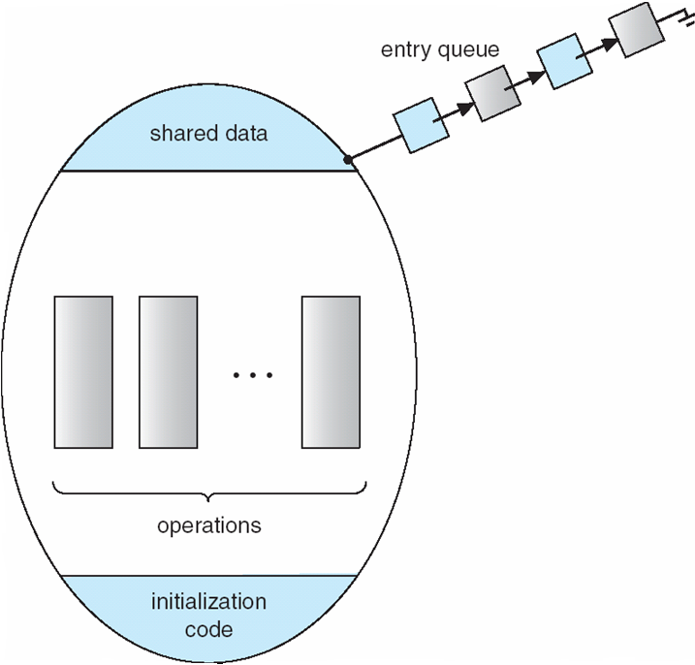
Schematic view of a Monitor

Slide 41
Solution to Dining Philosophers
enum { THINKING; HUNGRY, EATING) state [5] ;
condition self [5];
dp.pickup (i);
…………
.......
Eat
…….
……
dp.putdown (i);

Slide 42
Dining Philosophers Example
monitor dp
{
enum {thinking, hungry, eating} state[5];
condition self[5];
void pickup(int i) ;
void putdown(int i);
void test(int i);
void init() {
for (int i = 0; i < 5; i++)
state[i] = thinking;
}
}

Slide 43
Dining Philosophers
void pickup(int i) {
state[i] = hungry;
test(i);
if (state[i] != eating)
self[i].wait();
}
void putdown(int i) {
state[i] = thinking;
// test left and right
test((i+4) % 5);
test((i+1) % 5);
}
void test(int i) {
if ( (state[(i + 4) % 5] != eating) &&
(state[i] == hungry) &&
(state[(i + 1) % 5] != eating)) {
state[i] = eating;
self[i].signal();
}
}
Solution:
dp.pickup(i);
... eat ...
dp.putdown(i);

Slide 44
Solution to Dining Philosophers
monitor DP
{
enum { THINKING; HUNGRY, EATING) state [5] ;
condition self [5];
void pickup (int i) {
state[i] = HUNGRY;
test(i); // try to acquire two forks
if (state[i] != EATING) self [i].wait;
}
void putdown (int i) {
state[i] = THINKING;
// test left and right neighbors
test((i + 4) % 5); //see if left neighbor can now eat
test((i + 1) % 5); //see if right neighbor can now eat
}

Slide 45
Solution to Dining Philosophers (cont)
void test (int i) {
if ( (state[(i + 4) % 5] != EATING) &&
(state[i] == HUNGRY) &&
(state[(i + 1) % 5] != EATING) ) {
state[i] = EATING ;
self[i].signal () ;
}
}
initialization_code() {
for (int i = 0; i < 5; i++)
state[i] = THINKING;
}
}

Slide 46
Monitor Implementation (using semaphores)
Need mutual exclusion semaphore mutex (init to 1) so that only one process is active within monitor
Need a semaphore next (next to exit) for the signaling process to suspend itself
initialized to zero
next_count is number of processes blocked on next
Before exiting a procedure, process must either:
Signal other waiting processes in monitor (next) before exiting, or
Signal mutex and exit

Slide 47
Monitor Implementation
Since only one task may be active in a monitor there must be a mutex protecting each method.
We also need to account for sending signals within a monitor – that is, guard against having more than one active task within the monitor.
Our implementation uses semaphores for both mutual exclusion (initialized to 1 for a mutex) and counting the number of tasks waiting to be resumed within the monitor (initialized to 0 – counting semaphore)

Slide 48
Example Implementation
semaphore mutex; // protect monitor
semaphore next; // waiting to be resumed
int next_count = 0;
Each external method M will be replaced by
wait(mutex); // ensures mutual exclusion
… body of M; …
if (next_count > 0) // tasks waiting to be resumed
signal(next) // resume them
else
signal(mutex); // else unlock monitor
Mutual exclusion within a monitor is ensured.

Slide 49
Monitor Implementation
The monitor “compiler” has to automatically insert this code into compiled procedures:
Procedure F:
wait(mutex); //ensures mutual exclusion
...
body of F
...
if (next_count>0) // tasks waiting to be resumed
signal(next); // resume them
else
signal(mutex); // else unlock monitor
end;

Slide 50
Monitor Implementation
For each condition variable x, we have:
semaphore x_sem; // (initially = 0)
int x_count = 0;
The operation x.wait can be implemented as:
x_count++;
if (next_count > 0)
signal(next);
else
signal(mutex);
wait(x_sem);
x-count--;

Slide 51
Monitor Implementation
The operation x.signal can be implemented as:
if (x-count > 0) {
next_count++;
signal(x_sem);
wait(next);
next_count--;
}

Slide 52
Resuming processes within a monitor
How can we control the task resumption order?
Conditional-wait construct: x.wait(c);
c – integer expression evaluated when wait executed.
value of c (a priority number) stored with the name of the process that is suspended.
when x.signal is executed, process with smallest associated priority number is resumed next.

Slide 53
A Monitor to Allocate Single Resource
monitor ResourceAllocator
{
boolean busy;
condition x;
void acquire(int time) {
if (busy)
x.wait(time);
busy = TRUE;
}
void release() {
busy = FALSE;
x.signal();
}
initialization code() {
busy = FALSE;
} }
R.acquire(t);
…..
access the resource;
…….
R.release();

Slide 54
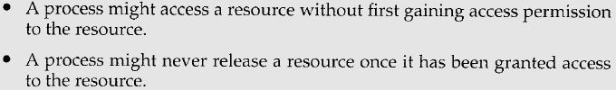

A Monitor to Allocate Single Resource
Problems:
Verifying correctness: Check two conditions:
User processes must always make their calls on the monitor in a correct sequence.
Must ensure that an uncooperative process does not ignore the mutual-exclusion gateway provided by the monitor, and try to access the shared resource directly, without using the access protocols.

Slide 55
Thank You

